Slide 1

 | LGTM
Adrian
Roxanne
AlphaEvolve
Solve harder problems with AlphaEvolve,
now available to everyone.

Slide 2

“AI is shifting from a productivity assistant that accelerates how we work to a discovery engine that expands what we can achieve.”
Pushmeet Kohli
Chief Scientist, Google Cloud & Vice President, Google DeepMind

Slide 3

Proprietary + Confidential
Many of the most challenging and potentially valuable problems in the world are related to optimization.
Minimize latency
in a data center
Maximize the stability
of a protein
Optimize route for
a logistics fleet
Notes:
Many of the most challenging and potentially valuable problems in the world are related to optimization. You might be trying to minimize latency in a data center, maximize the stability of a protein, or find the most efficient route for a logistics fleet.

Slide 4
At Google, we are using agentic AI tackle some of our own hard optimization and engineering problems.
In coding
In science
In computing
20%
reduction in
write amplification
through new compiler optimization strategies
5%
boost in predictive accuracy achieved across 20 natural disaster
risk categories
10x
lower error rates in quantum circuits for complex molecular simulations via Google’s Willow processor
Notes:
Data center efficiency: AlphaEvolve found a better way to schedule tasks in our data centers, continuously recovering on average 0.7% of our global compute resources.
Gemini training: AlphaEvolve sped up a vital kernel in Gemini’s architecture by 23%, leading to a 1% reduction in Gemini's training time.
Hardware design: It accelerated the design of our next-generation TPUs by discovering more efficient arithmetic circuits.

Slide 5
AlphaEvolve is an agent to help you design better algorithms for problems too vast for standard brute-force methods to explore effectively.

Slide 6







Now generally available, AlphaEvolve has already driven impact across diverse domains.
Supply chain
Genomics
Improved their existing planning and forecasting models by over 80%
Achieving a 30% reduction in variant detection errors
E-commerce
Marketing
Delivered a 10% lift in prediction accuracy and up to a 7% boost in downstream recommendation scores
Improved production forecast by over 5%
AlphaEvolve helps solve for algorithmic optimization
Doubled training speed and improve performance for their foundational models
Financial services
Supply Chain
Achieving improvements of more than 22% in key forecasting accuracy metrics while reducing runtime by over 90%
Notes:
BASF: Building a digital twin to optimize global supply chains
"We had several attempts to build a digital twin for our complex supply network using deterministic models, and all of them failed. By using AlphaEvolve, we cannot only map the complex network based on system data, but at the same time understand and copy the human decisions that drive our daily operations. This gives us a highly accurate and easy to maintain data driven digital twin of the entire network." — Dr. Goetz Krabbe, Vice President for Global Supply Chain, BASF.
Visit the blog to read more how BASF used AlphaEvolve to improve their existing planning and forecasting models by over 80%.
Coolblue: Optimizing e-commerce demand forecasting
“Coolblue data scientists used AlphaEvolve to directly optimize their 28-day demand forecasting pipeline, focusing on automated feature engineering, target preprocessing, and model selection. In just a few (200) iterations, AlphaEvolve improved our production forecast (by reducing WMAPE over the existing solution) by over 5%. These gains were achieved through improved feature engineering, an ensemble of different regression models, and better target preprocessing proposed and validated by AlphaEvolve. To ensure sufficient stock availability, it is crucial that the demand forecast is accurate for both the short term (the first 7 days) and the longer horizon (the full 28 days). AlphaEvolve achieved this by using an evaluation metric that combines both periods, along with a strict penalty for under forecasting. AlphaEvolve has proven its ability to significantly improve bulk purchasing decisions and help us maintain optimal stock levels for the weeks ahead.” — Cas Ruger, Data Scientist at Coolblue.
FM Logistic: Optimizing warehouse routing
"Through our partnership with Google Cloud and the implementation of AlphaEvolve and Gemini, we further optimized our routing approach for fast-moving operations.The 10.4% improvement was achieved on top of an already highly optimized baseline, where further gains are typically hard to come by. This translates directly to faster fulfillment, improved working conditions for our teams, and reduced wear on our fleet." — Rodolphe Bey, Group CIO at FM Logistic.
Visit the blog and website to read more about how FM Logistic used AlphaEvolve to improve warehouse routing by 10.4%, saving over 15,000 km in staff travel.
Infineon: Optimizing chip design
"Our initial experiments with AlphaEvolve have been very positive, demonstrating its potential to transform the chip design lifecycle. We see a clear potential for it to contribute to multiple stages of development, including areas like Surrogate modelling." — Michael Kollig, CIO, Infineon.
JetBrains: Accelerating IDE performance
"AlphaEvolve can change how we approach complex performance work. It turns optimizations that were once too time-consuming to explore into candidates we can test routinely. Engineers still own the benchmark, review, and release decision. The search space is what gets smaller." — Dmitrii Batkovich, Director of Engineering, JetBrains.
Visit the blog to read more about how Jetbrains used AlphaEvolve to improve their IDE performance by over 15-20%.
Kinaxis: Improving optimization and forecasting systems
"Kinaxis researchers have used AlphaEvolve to materially improve both the speed and quality of highly mature forecasting and optimization algorithms. In early testing, we achieved improvements of more than 22% in key forecasting accuracy metrics while reducing runtime by over 90% on benchmark datasets. As supply chains become increasingly complex and unpredictable, AlphaEvolve has the potential to help the world's largest organizations make faster, more informed decisions and adapt with greater confidence." — Gelu Ticala, Chief Technology Officer, Kinaxis
Visit the blog to read more about how Kinaxis used AlphaEvolve to achieve significant gains across their forecasting and runtime metrics.
Klarna: Doubling throughput while improving model quality
"Klarna applied AlphaEvolve to one of their largest ML training pipelines and doubled throughput while improving model quality, all under the strict reproducibility constraints of regulated financial services. Over three weeks, the system explored nearly 6,000 candidate programs, discovering deep architectural rewrites no engineer would have tried." — Klarna engineering team.
Visit the blog to read more about how Klarna used AlphaEvolve to double Training Speed and improve performance for their foundational models.
Oak Ridge National Laboratory: GPU kernel generation for exascale computing
Oak Ridge National Laboratory (ORNL) recently partnered with Google to deploy AlphaEvolve on Frontier, the world’s first exascale supercomputer. The research team built a closed-loop evaluation architecture that bridges cloud-based large language model code generation with Frontier’s execution environment. The designed system optimizes mixed-precision GPU kernels—which requires complex, coupled decisions about memory, data layout, and hardware synchronization — by iteratively generating, compiling, running, and validating candidate programs, directly on the supercomputer's AMD GPUs. This executable search framework evaluates each proposed structural optimization against numerical accuracy rules.
“Our collaboration with Google's AlphaEvolve team gave us an early look at how evolutionary programming can be combined with leadership-class supercomputing. By running AlphaEvolve on Frontier, we explored a large number of optimization candidates in parallel, including novel implementation variants that helped us explore parts of the design space we might not have reached through manual optimization alone. This is an encouraging first step toward applying AI-assisted optimization to increasingly complex scientific software." — Oscar Hernandez Mendoza, PhD, Senior Computer Scientist, ORNL
Old Dominion University: Modeling biological aging mortality rates
"The Qin Lab at Old Dominion University used AlphaEvolve to search the space of Python programs that model biological aging mortality rates, a problem in computational biogerontology where the governing equations span multiple empirical laws. Utilizing an HPC cluster in Google Cloud as a part of the ODU MonarchSphere initiative, AlphaEvolve – across approximately 500 evaluations – independently rediscovered the Kannisto logistic mortality model (a published result from the 1990s biogerontology literature) with no prior knowledge of that literature, improved the Emergent Aging Model composite fitness score by 19% through heterogeneous decay rate distributions, and demonstrated near-perfect Strehler-Mildvan correlation (0.949) via scale-free network topology with Laplacian spectral aging across approximately 500 evaluations. The central finding is that structurally diverse models all converge on the same empirical aging laws, providing evidence that Gompertz, Strehler-Mildvan, and Kannisto regularities are robust attractors of biological systems. The team plans to extend this work to multi-species datasets and to connect the evolved program structures to testable biological mechanisms.” — Dr. Hong Qin,Department of Computer Science, Old Dominion University
PacBio: Scaling accuracy and lowering costs in genomics
"The solution the Google team discovered using AlphaEvolve unlocks meaningfully higher accuracy rates for our sequencing instruments. For researchers, this higher-quality data might enable the discovery of previously hidden disease-causing mutations." — Aaron Wenger (Senior Director, PacBio).
Visit the blog to read more about how Pacbio used AlphaEvolve AlphaEvolve was used to improve DeepConsensus — a model developed by Google Research for correcting DNA sequencing errors — achieving a 30% reduction in variant detection errors.
Pebble: Optimizing serving performance on GPUs
"Optimizing inference serving is an incredibly challenging problem because it is a multi-dimensional system design challenge that shifts dynamically between memory, compute, and hardware orchestration constraints. NVIDIA's AI Configurator latency model was severely bottlenecked by a single, static 0.8 empirical correction factor that applied uniformly to all workloads, and did not model FP8-vs-BF16 efficiency divergence, causing recommended configurations to drift away from the optimum.
AlphaEvolve solved this by autonomously discovering GPU performance modeling formulations directly from our training prior. This Gemini-powered evolutionary approach drastically cut our model errors by more than delivering a 56% relative error reduction. We are excited to integrate this smoother, learned efficiency function and leverage AlphaEvolve to continuously map emerging hardware specifications without manual tuning." — Keval Shah Head of AI, Pebble
Qbraid: Advancing quantum computing
"AlphaEvolve delivered a result on top of an encoding family we had already spent years refining. It searched a design space far too large to comb through by hand and handed back something we could read, verify, and understand. Systems like AlphaEvolve will meaningfully accelerate progress toward useful quantum computing." — Kenny Heitritter, Vice President of Research and Development at qBraid.
Visit the blog and paper to read more about how Qbraid used AlphaEvolve to find significantly more error efficient error-correcting codes for quantum chemistry.
Schrödinger: Shortening cycles for molecular simulations for drug discovery
"AlphaEvolve allows us to explore larger chemical spaces faster and more efficiently than ever before. Faster MLFF inference carries real business impact, shortening R&D cycles in drug discovery, catalyst design, and materials development, and enabling companies to screen molecular candidates in days rather than months." — Gabriel Marques, ML Tech Lead, Schrödinger.
Visit the blog to read more about how Schröedinger used Alphaevolve to quadruple the speed of molecular discovery.
Substrate: Accelerating runtime speed for semiconductor simulation
“AlphaEvolve transformed the speed and efficiency of our computational lithography frameworks and, more impressively, demonstrated the potential of these models to design their future selves, all the way down to the atoms.” — James Proud, CEO, Substrate.
Visit the blog to read more about how Substrate applied AlphaEvolve to its computational lithography framework, achieving a multi-fold increase in runtime speed, enabling them to run significantly larger simulations of advanced semiconductors.
WPP: Cracking the code of campaign success
"WPP faced a ceiling in predicting creative campaign performance, as their manual model optimizations yielded only marginal 1% accuracy gains despite significant time and effort. To overcome this challenge, WPP’s Research team utilized AlphaEvolve to autonomously propose, evaluate, and refine candidate model architectures rather than relying on slow manual experimentation. This agentic framework effectively bypassed their trial-and-error limits, successfully navigating complex, high-dimensional campaign data and class imbalances. As a result, WPP achieved a highly significant 5–10% (across different use cases) increase in both prediction accuracy and downstream recommendation scores, outperforming all previous baseline models including neural and fine-tuned Gemma models" — Anastasios Tsourtis, Lead Data Scientist, WPP.
Visit the blog to read more about how WPP used Alphaevolve to optimize machine learning models for digital marketing campaigns, delivering a 10% lift in prediction accuracy and up to a 7% boost in downstream recommendation scores.

Slide 7
Treating your most complex processes as code and systematically identifying more efficient ways to run them.
AlphaEvolve iterative loop
Gemini
models
Automated evaluator
Ground truth evaluator
New parent program
Performance Check
YES
(better performance)
V2.0
Seed algorithm
list_alt_check
Optimized algorithm
Creatively proposes new code changes and algorithms
Verifies answers for functional correctness
Performance check against user-defined ground truth
Becomes
basis for next generation
Internal loop
decision - continue or back to Gemini
NO
(worse performance)
Becomes parent

Slide 8
Leverage AlphaEvolve with four easy steps:
Define
Measure
Optimize
Apply
Define the problem and baseline algorithm
Evaluate
and score performance
and correctness
Evolve code to optimize it for your problem
Review and deploy new algorithm directly to production
search
bar_chart
code
deployed_code

Slide 9
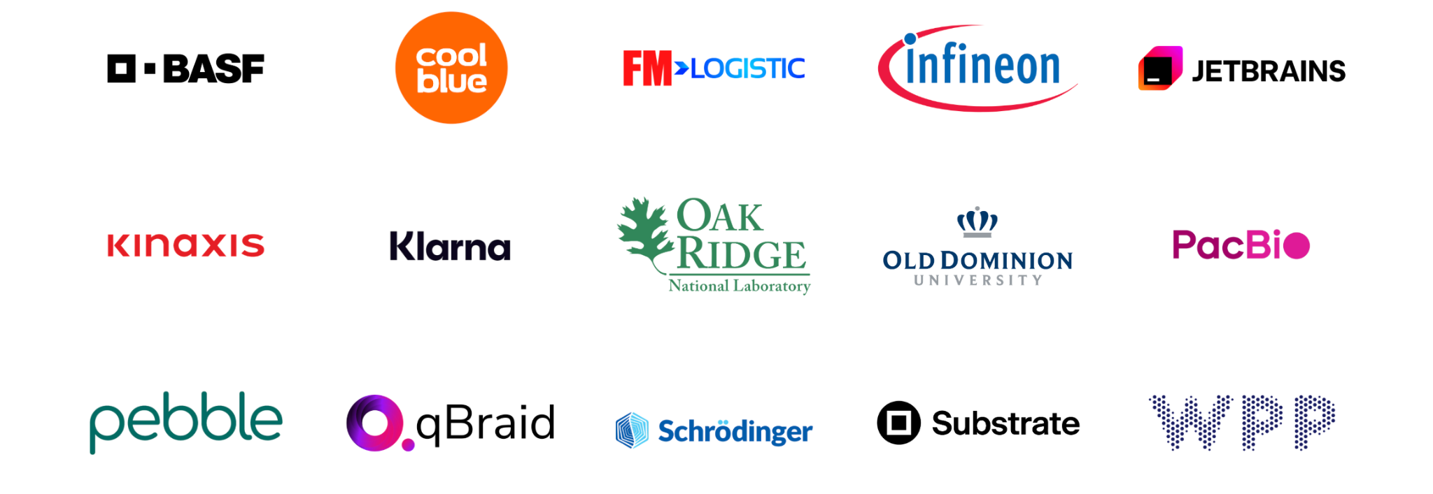
Some of the world’s most innovative organizations are using it to solve their algorithmic problems:
AlphaEvolve achieved impact at
and more!

Slide 10
Start evolving your codebase today with just two inputs.
Seed program
The initial algorithm written as code.
You designate which segments of code are open to optimization and provide them to AlphaEvolve.
Evaluators
A deterministic client-side evaluation script
that compiles, tests, and scores the mutated candidates, returning one or more scalar metrics
for AlphaEvolve to maximize.
energy_program_time_used
search
Onboarding setup API: AlphaEvolve developer guide
Codelabs and samples: AlphaEvolve GitHub repository

Slide 11
Demo
Notes:
Demo optional

Slide 12

Design note: if possible include photo
The traveling salesman problem:
How does a logistic giant find the most efficient
route to visit dozens of different destinations?
What makes this hard to solve?
Exponential scale: As logistics routes expand, the mathematical possibilities explode
How does AlphaEvolve help?
An agentic AI partner that autonomously initializes, writes, and evolves code.
What is the real world Impact?
10.4% improvement in warehouse routing by saving over 15,000 km in staff travel for FM Logistic
The ultimate logistics puzzle: how does a fleet find the absolute shortest possible route to visit dozens of different destinations?
The Challenge - Exponential Scale: As logistics routes expand, the mathematical possibilities explode. Traditional brute-force routing stalls, and writing custom optimization algorithms manually takes weeks.
The AlphaEvolve Solution: An agentic AI partner that autonomously initializes, writes, and evolves code.
The FM Logistics Impact: Achieved massive operational efficiency over just 7 autonomous code-generation iterations, drastically reducing route distance and compute latency.
10.4% improvement in routing efficiency over the previous best solution.
15,000+ fewer kilometers of warehouse travel per year at full operational scale.
Notes:
When we talk to supply chain and operations leaders, almost everyone runs into some version of the 'Traveling Salesman Problem.' It's the ultimate logistics puzzle: how does a fleet find the absolute shortest possible route to visit dozens of different destinations?
Here’s why it’s notoriously difficult: it’s an example of (what computer scientist’s consider) a 'NP-hard' problem. The math scales exponentially. If you have 10 delivery stops, there’s over 3 million possible route combinations. If you just add five more stops to make it 15, that number explodes to over 1 trillion combinations. Brute-forcing that takes massive compute power, and relying on engineers to manually write and tune custom algorithms takes weeks. This is also true for 3D Bin Packing in warehouse and supply chain, job scheduling and assembly line balancing in manufacturing, vehicle and inventory routing optimization in Retail & CPG, and molecular docking and protein folding for R&D and Drug Discovery. Historically, solving these problems required human creation of specialized mathematical models and weeks of manual code tuning.
This was exactly the bottleneck FM Logistics, one of our customers, was facing. They needed a way to optimize these routes without stalling their systems or tying up their engineering teams. Instead of human developers manually writing this complex math from scratch, they used AlphaEvolve.
It’s key to understand AlphaEvolve didn’t just generate code; it acted as an agentic partner that wrote and tested its own algorithms, capturing insights and learning as it hillclimbed to find an entirely new solution that hit a specific optimization target. Given an initial set of boundaries, an initial program, and a fitness function, AlphaEvolve autonomously used Gemini to write the pathfinding code, received evaluation scoring from FM Logistic’s proprietary scoring algorithms, and evolved its own code with diverse mutations to intelligently drive breakthrough.
To show you exactly what this looks like in action, I’m going to pull up a quick demo of how we solved this for the logistics space.

Slide 13
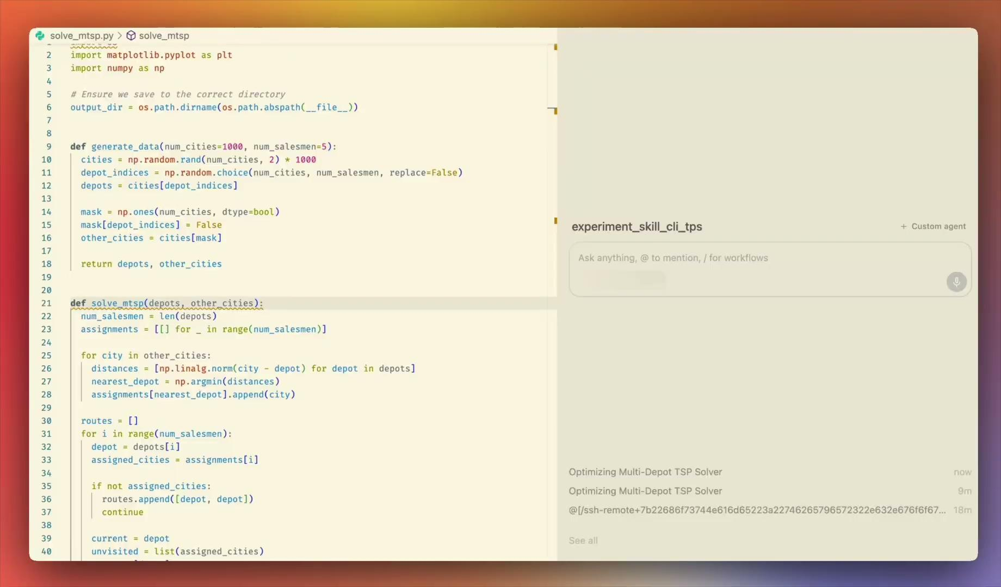
Watch AlphaEvolve in action
Notes:
Queue up video: In this demo, we’re going to show how AlphaEvolve automated the entire evolutionary process, using the reasoning and mathematical capabilities of Gemini to uniquely apply and integrate mathematical principles to come up with novel logic. This demo specifically demonstrates how to use AlphaEvolve via Antigravity (Google’s Agentic Development Platform). We’ve created several agentic skills that empower Antigravity to support throughout the end-to-end AlphaEvolve workflow.
During Video:
Walkthrough
To begin, you need to curate your AlphaEvolve inputs. You can see how the user identifies the initial program, or ‘seed’ program. You can also see the user specifying a specific business objective: ‘minimize total trip length across 10 city maps’. The user also specifies constraints (e.g. Python only).
[@ ~ 0:50] The user then partners with Antigravity to optimize the initial program, define the experiment specifications, and create/host the evaluation code that will score all of the candidates generated by AlphaEvolve.
[@ ~1:17] Now you can see the actual AlphaEvolve experiment get kicked off. AlphaEvolve captures the deep structural knowledge of a business problem, maps out the mathematical constraints, and applies advanced optimization paradigms to traverse thousands of possibilities. Watch how it autonomously synthesizes a tailored algorithmic solution that a human engineer might spend weeks white-boarding, while also seeking and aligning with the user on the direction and its changes.
[@ ~1:40 secs] The ‘Score improvement per iteration’ chart shows the results of AlphaEvolve’s hill climbing, showing how the score improved with each iteration.
Close out: As you just saw, AlphaEvolve went far beyond basic code generation by fundamentally re-engineering the underlying mathematical logic to discover the absolute optimal solution for the problem. Let’s look at how this ability to translate complex engineering into raw, bottom-line impact has already driven massive success for our early customers.

Slide 14

Logistics
“The 10.4% improvement was achieved on top of an already highly optimized baseline, where further gains are typically hard to come by.
This translates directly to faster fulfillment, improved working conditions for our teams, and reduced wear on our fleet.”
Rodolphe Bey
Group CIO, FM Logistic
Notes:
FM Logistic: Optimizing warehouse routing
"Through our partnership with Google Cloud and the implementation of AlphaEvolve and Gemini, we further optimized our routing approach for fast-moving operations.The 10.4% improvement was achieved on top of an already highly optimized baseline, where further gains are typically hard to come by. This translates directly to faster fulfillment, improved working conditions for our teams, and reduced wear on our fleet." — Rodolphe Bey, Group CIO at FM Logistic.
Visit the blog and website to read more about how FM Logistic used AlphaEvolve to improve warehouse routing by 10.4%, saving over 15,000 km in staff travel.

Slide 15
Customer stories
Notes:
Heather

Slide 16
Supply chain
“We had several attempts to build a digital twin for our complex supply network using deterministic models, and all of them failed. By using AlphaEvolve, we cannot only map the complex network based on system data, but at the same time understand and copy the human decisions that drive our daily operations.” This improved models by over 80%.
Dr. Goetz Krabbe
Vice President for Global Supply Chain, BASF.
Notes:
BASF: Building a digital twin to optimize global supply chains
"We had several attempts to build a digital twin for our complex supply network using deterministic models, and all of them failed. By using AlphaEvolve, we cannot only map the complex network based on system data, but at the same time understand and copy the human decisions that drive our daily operations. This gives us a highly accurate and easy to maintain data driven digital twin of the entire network." — Dr. Goetz Krabbe, Vice President for Global Supply Chain, BASF.
Visit the blog to read more how BASF used AlphaEvolve to improve their existing planning and forecasting models by over 80%.
Visit the blog to read more about how WPP used Alphaevolve to optimize machine learning models for digital marketing campaigns, delivering a 10% lift in prediction accuracy and up to a 7% boost in downstream recommendation scores.

Slide 17
E-commerce
“Coolblue data scientists used AlphaEvolve
to directly optimize their 28-day demand forecasting pipeline, focusing on automated feature engineering, target preprocessing, and model selection. In just a few (200) iterations, AlphaEvolve improved our production forecast (by reducing WMAPE over the existing solution) by over 5%.”
Cas Ruger
Data Scientist at Coolblue
Notes:
Coolblue: Optimizing e-commerce demand forecasting
“Coolblue data scientists used AlphaEvolve to directly optimize their 28-day demand forecasting pipeline, focusing on automated feature engineering, target preprocessing, and model selection. In just a few (200) iterations, AlphaEvolve improved our production forecast (by reducing WMAPE over the existing solution) by over 5%. These gains were achieved through improved feature engineering, an ensemble of different regression models, and better target preprocessing proposed and validated by AlphaEvolve. To ensure sufficient stock availability, it is crucial that the demand forecast is accurate for both the short term (the first 7 days) and the longer horizon (the full 28 days). AlphaEvolve achieved this by using an evaluation metric that combines both periods, along with a strict penalty for under forecasting. AlphaEvolve has proven its ability to significantly improve bulk purchasing decisions and help us maintain optimal stock levels for the weeks ahead.” — Cas Ruger, Data

Slide 18
Financial services
“Klarna applied AlphaEvolve to one of their largest ML training pipelines and doubled throughput while improving model quality,
all under the strict reproducibility constraints of regulated financial services. Over three weeks, the system explored nearly 6,000 candidate programs, discovering deep architectural rewrites no engineer would
have tried.”
Klarna engineering team
Notes:
Klarna: Doubling throughput while improving model quality
"Klarna applied AlphaEvolve to one of their largest ML training pipelines and doubled throughput while improving model quality, all under the strict reproducibility constraints of regulated financial services. Over three weeks, the system explored nearly 6,000 candidate programs, discovering deep architectural rewrites no engineer would have tried." — Klarna engineering team.
Visit the blog to read more about how Klarna used AlphaEvolve to double Training Speed and improve performance for their foundational models.
Visit the blog to read more about how WPP used Alphaevolve to optimize machine learning models for digital marketing campaigns, delivering a 10% lift in prediction accuracy and up to a 7% boost in downstream recommendation scores.

Slide 19
Genomics
“The solution the Google team discovered using AlphaEvolve unlocks meaningfully higher accuracy rates for our sequencing instruments. For researchers, this higher-quality data might enable the discovery of previously hidden disease-causing mutations.”
Aaron Wenger
Senior Director PacBio
Notes:
PacBio: Scaling accuracy and lowering costs in genomics
"The solution the Google team discovered using AlphaEvolve unlocks meaningfully higher accuracy rates for our sequencing instruments. For researchers, this higher-quality data might enable the discovery of previously hidden disease-causing mutations." — Aaron Wenger (Senior Director, PacBio).
Visit the blog to read more about how Pacbio used AlphaEvolve AlphaEvolve was used to improve DeepConsensus — a model developed by Google Research for correcting DNA sequencing errors — achieving a 30% reduction in variant detection errors.
Visit the blog to read more about how WPP used Alphaevolve to optimize machine learning models for digital marketing campaigns, delivering a 10% lift in prediction accuracy and up to a 7% boost in downstream recommendation scores.

Slide 20
Marketing
“This agentic framework effectively bypassed their trial-and-error limits, successfully navigating complex, high-dimensional campaign data and class imbalances.
As a result, WPP achieved a highly significant
5–10% (across different use cases) increase
in both prediction accuracy and downstream recommendation scores.”
Anastasios Tsourtis
Lead Data Scientist, WPP
Notes:
WPP: Cracking the code of campaign success
"WPP faced a ceiling in predicting creative campaign performance, as their manual model optimizations yielded only marginal 1% accuracy gains despite significant time and effort. To overcome this challenge, WPP’s Research team utilized AlphaEvolve to autonomously propose, evaluate, and refine candidate model architectures rather than relying on slow manual experimentation. This agentic framework effectively bypassed their trial-and-error limits, successfully navigating complex, high-dimensional campaign data and class imbalances. As a result, WPP achieved a highly significant 5–10% (across different use cases) increase in both prediction accuracy and downstream recommendation scores, outperforming all previous baseline models including neural and fine-tuned Gemma models" — Anastasios Tsourtis, Lead Data Scientist, WPP.
Visit the blog to read more about how WPP used Alphaevolve to optimize machine learning models for digital marketing campaigns, delivering a 10% lift in prediction accuracy and up to a 7% boost in downstream recommendation scores.

Slide 21

Semiconductor
“Our initial experiments with AlphaEvolve have been very positive, demonstrating its potential to transform the chip design lifecycle. We see
a clear potential for it to contribute to multiple stages of development, including areas like Surrogate modelling.”
Michael Kollig
CIO, Infineon
Notes:
"Our initial experiments with AlphaEvolve have been very positive, demonstrating its potential to transform the chip design lifecycle. We see a clear potential for it to contribute to multiple stages of development, including areas like Surrogate modelling." — Michael Kollig, CIO, Infineon.

